Slide 1
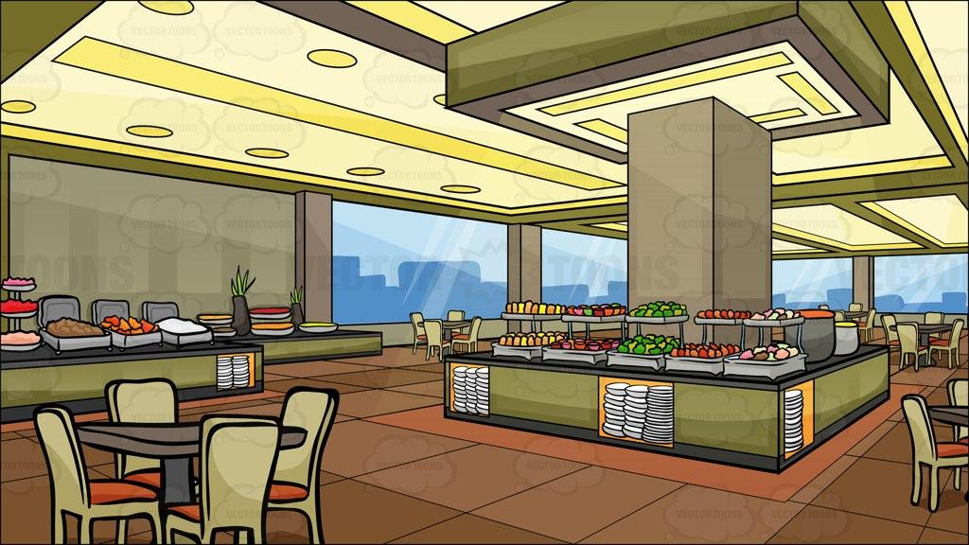


For Player1 or the blue candy, the player would use the a,w,s,d, keys and the spacebar to play.
a~ left
w~ up
s~ down
d~ right
Spacebar ~ shoot (2nd level)
For Player2 or the pink candy , the player would use the arrow keys and the enter key on the keypad to play
← ~ left
→ ~ right
↓ ~ down
↑ ~ up
Enter ~ shoot

